Slide 1

Face Classification: A Specialized Benchmark Study
Project Page: https://davidsonic.github.io/index/ccbr_2016
Code (github): https://github.com/davidsonic/face_classification_ccbr2016
Jiali Duan , Shengcai Liao, Shuai Zhou, and Stan Z. Li
School of Electrical, Electronic and Communication Engineering, University of Chinese Academy of Sciences
Center for Biometrics and Security Research & National Laboratory of Pattern Recognition, Institute of Automation, Chinese Academy of Sciences
Macau University of Science and Techonology
Thanks corresponding author

Slide 2
Introduction
1. Face detection is a key fundamental problem in facial anaysis
Face Recognition
Face Alignment
Face Attribute Analysis
2. It’s the first step for other high-level tasks such as ……

Slide 3
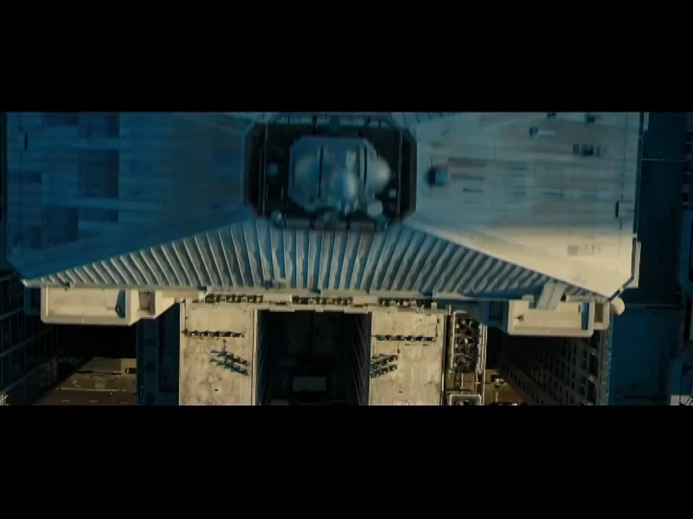

Slide 4
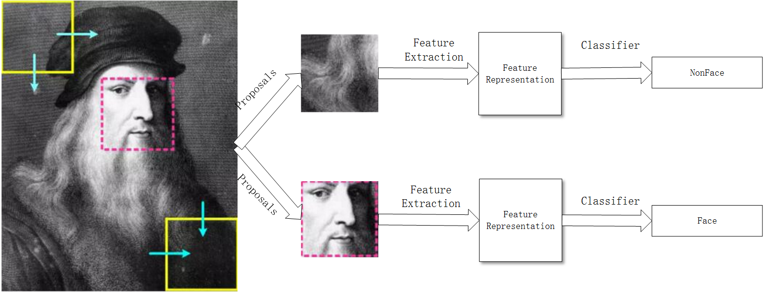
Face detection generally involves three steps:
Post-Processing
Block Generation
Face Classification

Slide 5
Problems
1. The performace of face detection is largely influenced by other two steps, concealing the performance of face classification.
2. Implementing and optimizing all three steps results in a very heavy work, which is a big barrier for those who only cares about classification

Slide 6
Motivations
1. We start with face proposals, and build a benchmark dataset with about 3.5 million patches for two-class face/non-face classification
2. Several baselines with respect to feature extraction methods and classification methods have been demonstrated.

Slide 7
Related Works
Popular benchmark face dataset include: AFW [1], FDDB [2], WIDER FACE [3] benchmarks all require that researchers start from scratch
[1] Zhu, Xiangxin and Ramanan, Deva. Face detection, pose estimation, and landmark localization in the wild: Computer Vision and Pattern Recognition (CVPR), 2012
[2] Vidit Jain and Erik Learned-Miller. FDDB: A Benchmark for Face Detection in Unconstrained Settings. TechReport: UM-CS-2010-009, 2010
[3] Yang, Shuo and Luo, Ping and Loy, Chen Change and Tang, Xiaoou. WIDER FACE: A Face Detection Benchmark: IEEE Conference on Computer Vision and Pattern Recognition (CVPR), 2016

Slide 8
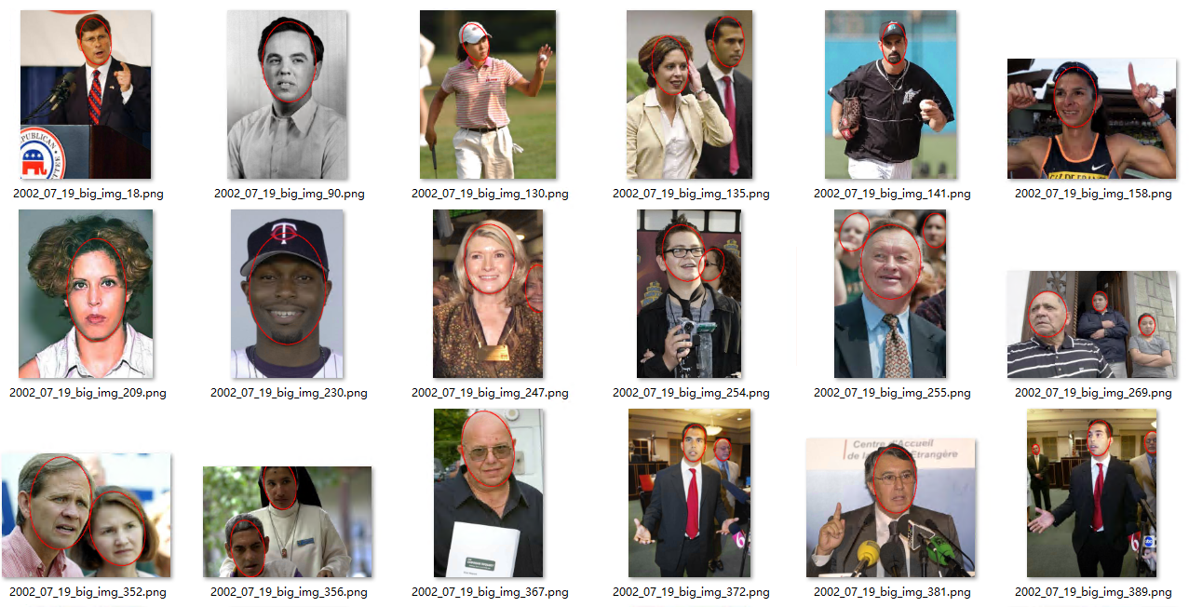

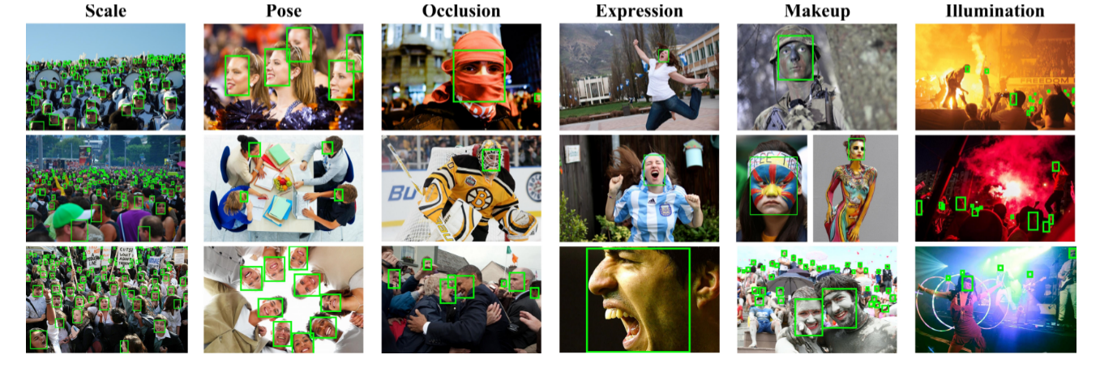
WIDER FACE
AFW
FDDB

Slide 9
Face Classificaiton Benchmark
1. RPN network is employed to extract proposals inspired by the work of Faster-RCNN [1] and its recent application in face detection [2]
2. Generic object proposal-generating methods such as [3] are not very suitable for our benchmark because the amount of positive patches generated is too scarce and those are not as discrimative as a specially trained RPN face proposal network
Ren S, He K, Girshick R, et al. Faster R-CNN: Towards real-time object detec-tion with region proposal networks. In: Advances in neural information processing systems. 2015: 91-99
Jiang H, Learned-Miller E. Face Detection with the Faster R-CNN. arXiv preprintarXiv:1606.03473, 2016.
Van de Sande K E A, Uijlings J R R, Gevers T, et al. Segmentation as selectivesearch for object recognition: International Conference on Computer Vision. IEEE, 2011: 1879-1886.

Slide 10
Some Specifics
Using Zeiler and Fergus [1] model
All proposals are generated from the training set of WIDER FACE [2] containing 12880 high-resolution images
About 300 proposals each image
1. Zeiler M D, Fergus R. Visualizing and understanding convolutional networks: Eu-ropean Conference on Computer Vision. In: Springer International Publishing, 2014:818-833
2. Yang, Shuo and Luo, Ping and Loy, Chen Change and Tang, Xiaoou. WIDER FACE: A Face Detection Benchmark: IEEE Conference on Computer Vision and Pattern Recognition (CVPR), 2016

Slide 11
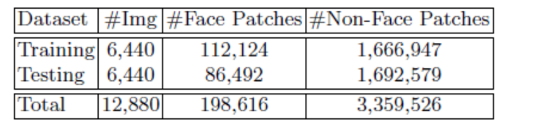
Details of FCB Benchmark
Measure Intersection over Union (IOU) between a proposal generated by RPN and a ground truth to determine positive and negative samples
is greater than 0.5 ➔ face patch
Less than 0.3 ➔ non face patch
5. The proposed Face Classification Benchmark contains 3,558,142 proposals in total, of which 198,616 being face patches. All images are resized to 24x24

Slide 12
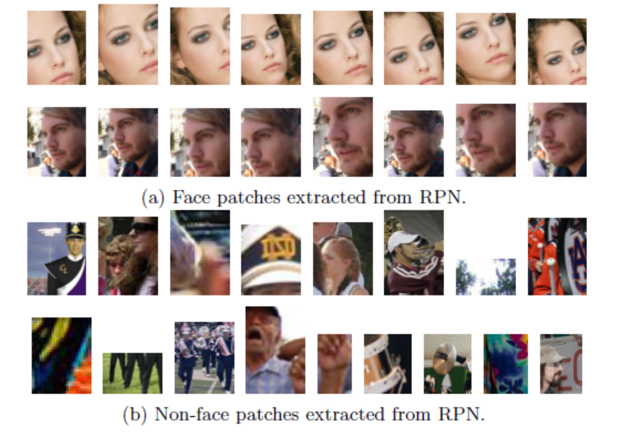
Sample Proposals of Proposed Benchmark

Slide 13
Benchmark Protocol
Proposals from the first 6440 images are used as training set, while the remaining proposals from the rest 6440 images are used as testing set.
In the testing set, the size of Non-face patches are about 20 times the size of face patches. Therefore, if an algorithm classifies all positive samples as negative ones, it would still get 95% two class classification accuracy!
Speciﬁcally, we measure the true positive rate at FAR=10−3 to compare the performance of diﬀerent algorithms. Since there are altogether 1,779,071 proposals extracted from 6,440 images in the test set, it means we only allow for False Positive Per Image (FPPI) of 0.28 in an image, which is both challenging and persuasive in terms of real world applications.
To reveal the ’true’ performance of a face classiﬁer, we put stress on per-formance at low False Accept Rate (FAR). The performance of the proposed algorithms are displayed via ROC curve by vary-ing the conﬁdent score threshold, with FAR in log space being the x axis and True Positive Rate (TPR) being the y axis.

Slide 14
Evaluation & Results
Tradition Methods:
Illumination-invariance is obtained in LOMO [1] by applying the Retinex transform and the Scale Invariant Local Ternary Pattern (SILTP) for feature representation.
NPD [2] gives the nice properties of scale-invariance, bounded-ness and its feature involves only two pixel values, hence robust to occlusion and blur or low image resolution.
LBP [3] together with its variant MB-LBP [4] are also re-implemented for evaluation.
We adopt DQT+boosting [2] as our baseline classiﬁer.
We also tried SVM, but it appears to be not eﬀective to handle this challenging problem, and it is also not eﬃcient for our large-scale data. Therefore, we leaved SVM out ﬁnally.

Slide 15
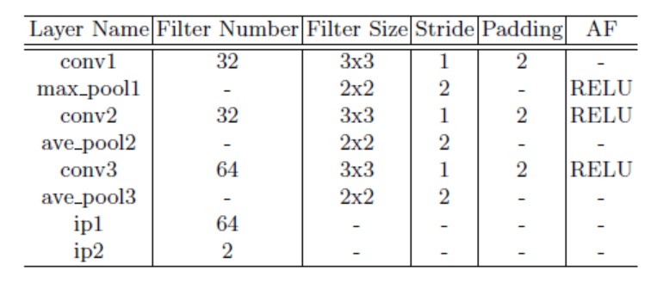
CNN Methods:
CIFAR-10 Net [5] based binary classiﬁcation CNN
Cascade-CNN following the paradigm of [6] have been implemented
Liao S, Hu Y, Zhu X, et al. Person re-identiﬁcation by local maximal occurrence rep-resentation and metric learning: Proceedings of the IEEE Conference on Computer Vision and Pattern Recognition. 2015: 2197-2206.
Liao, S and Jain, AK and Li, SZ. A Fast and Accurate Unconstrained Face Detector:EEE transactions on pattern analysis and machine intelligence, 2016, 38(2):211–223
Ojala T, Pietikainen M, Maenpaa T. Multiresolution gray-scale and rotation invari-ant texture classiﬁcation with local binary patterns: IEEE Transactions on patternanalysis and machine intelligence, 2002, 24(7): 971-987.
Liao S, Zhu X, Lei Z, et al. Learning multi-scale block local binary patterns for facerecognition: International Conference on Biometrics. Springer Berlin Heidelberg, 2007: 828-837
The CIFAR-10 dataset, https://www.cs.toronto.edu/~kriz/cifar.html
Li H, Lin Z, Shen X, et al. A convolutional neural network cascade for face detec- tion: Proceedings of the IEEE Conference on Computer Vision and Pattern Recog-nition. 2015: 5325-5334.

Slide 16
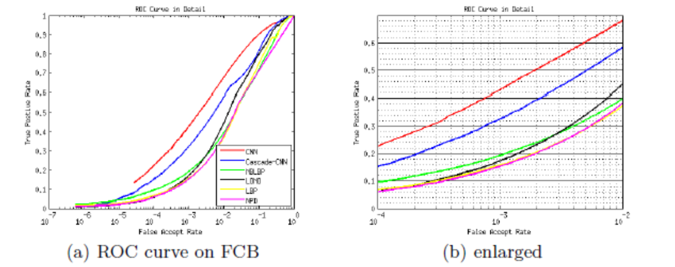
Results
CIFAR-10 based CNN beats other methods due to its powerful representation ability
It also outperforms Cascade-CNN by a large margin. This is probably because in the process of cascade training, hard negative samples mined by the last net contain a proportion of non-face patch-es that actually contain faces but with a IOU less than 0.3, thus ’too hard’ to identify for a shallow net structure

Slide 17
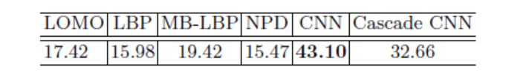
Detection rate (%) of each algorithm at FAR=10−3
As for hand-crafted features, MB-LBP obtains about 20% detection rate compared to LBP (about 16%) detection rate at FAR of 10−3
At FAR of 10−3, LOMO performs slightly better than LBP, but its true pos-itive rate increases rapidly as we move along the righthand direction of x axis.
NPD achieves comparable performance compared to LBP. As its values are computed involv-ing only two pixels of an image, NPD is more sensitive than other algorithms considering that face patches on FCB are not aligned.
At FAR of 10−2, the over-all rank is almost the same except that LOMO performs better than MB-LBP.

Slide 18
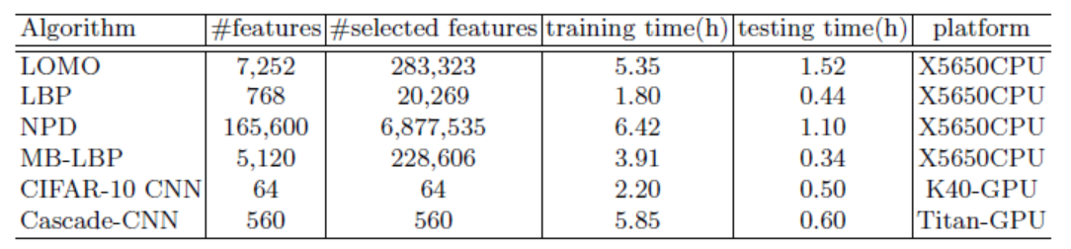
Model details and speed of each algorithm
About the dimension of the original features and selected features by the DQT based AdaBoost, as well as the training time, testing time and platform of each algorithm employed in our evaluation.
Note that LOMO requires RGB images while other methods use gray images as input.
The ﬁrst 4 algorithms are all combination of feature extraction and boosting with Deep Quadratic Trees (DQT) while the last two are end to end CNN methods, therefore the dimension of original features and selected features are the same.

Slide 19
Conclusion
1. It is not easy to determine the actual performance of the face classiﬁcation part due to the large inﬂuence of block generation and post-processing in traditional benchmarks. Motivated by this, we conduct a special-ized benchmark study in this paper, which focuses purely on face classiﬁcation.
2. We start with face proposals by collecting about 3.5 millions of face and non-face sample patches, and build a benchmark dataset (FCB) for two-class face classi-ﬁcation evaluation.
3. Our results show that, without the help of post-processing, the performance of face classiﬁcation itself is still not very satisfactory, even with a powerful CNN method.
4. The data and evaluation code of this study will be re-leased to the public to help assess performance of face classiﬁcation, and ease the participation of other related researchers who want to try their algorithms for face detection.

Slide 20
Face Classification: A Specialized Benchmark Study
Project Page: https://davidsonic.github.io/index/ccbr_2016
Code (github): https://github.com/davidsonic/face_classification_ccbr2016
Jiali Duan , Shengcai Liao, Shuai Zhou, and Stan Z. Li
School of Electrical, Electronic and Communication Engineering, University of Chinese Academy of Sciences
Center for Biometrics and Security Research & National Laboratory of Pattern Recognition, Institute of Automation, Chinese Academy of Sciences
Macau University of Science and Techonology
Thanks corresponding author

